Slide 1


School of Computing Science and Engineering
Course Code : CSAI3051 Course Name: ANN Deep Learning
Convolutional Neural Network
Name of the Faculty: K. Hariprasath Program Name: B.Tech

Slide 2
Outline
Convolutional Neural Network (CNN)
Layers in CNN
Name of the Faculty: K. Hariprasath Program Name: B.Tech

Slide 3
Convolution Neural Network (CNN)
This is used for labelling, objects detections, and face recognition, speech and image processing which is particularly useful in computer vision.
It has some similarities to the feed-forward neural network, where the connections between units have weights that determine the influence of one unit on another unit.
But a CNN has one or more than one convolutional layers that use a convolution operation on the input and then pass the result obtained in the form of output to the next layer.
More Details with Deep Learning Part.
Name of the Faculty: K. Hariprasath Program Name: B.Tech

Slide 4
Layers of CNN
The goal of CNN is to reduce the images so that it would be easier to process without losing features that are valuable for accurate prediction.
It has mainly SIXkinds of layers:
Input layer
Convolutional layer with Activation function
Pooling layer
Flattening layer
Fully-connected layer
Output layer
Name of the Faculty: K. Hariprasath Program Name: B.Tech

Slide 5
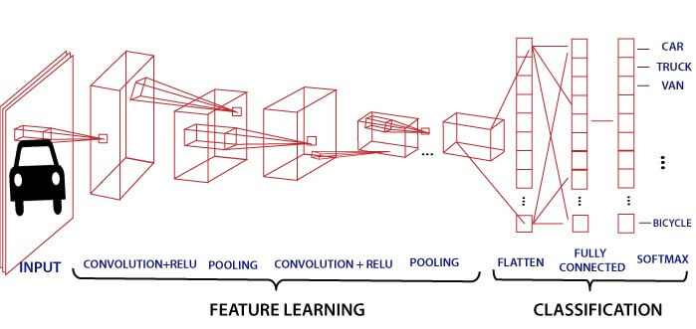
Layers of CNN and Working
Name of the Faculty: K. Hariprasath Program Name: B.Tech

Slide 6
Input Layer of CNN
This layer should contain image data.
Image data is represented by three dimensional as width, height and depth.
Sometimes pre-processing is required.
Name of the Faculty: K. Hariprasath Program Name: B.Tech

Slide 7
Convolution Layer of CNN
This layer is sometimes called feature extractor layer
It is used to extract the image features like edge, corners, line.
It computing the output by doing the dot product between all filter and image.
Example if total filter=12
Then output= 32*32*12
Activation function is also applied on output of convolution layer.
Types of Activation functions: Step / Relu / Sigmoid / Softmax
Name of the Faculty: K. Hariprasath Program Name: B.Tech

Slide 8
Pooling Layer of CNN
Pooling layer is used to reduce the size of input image after convolution.
It prevent over fitting.
Reduce computational cost.
Various Types of Pooling:
Max Pooling
Min Pooling
Average Pooling
…
Name of the Faculty: K. Hariprasath Program Name: B.Tech

Slide 9
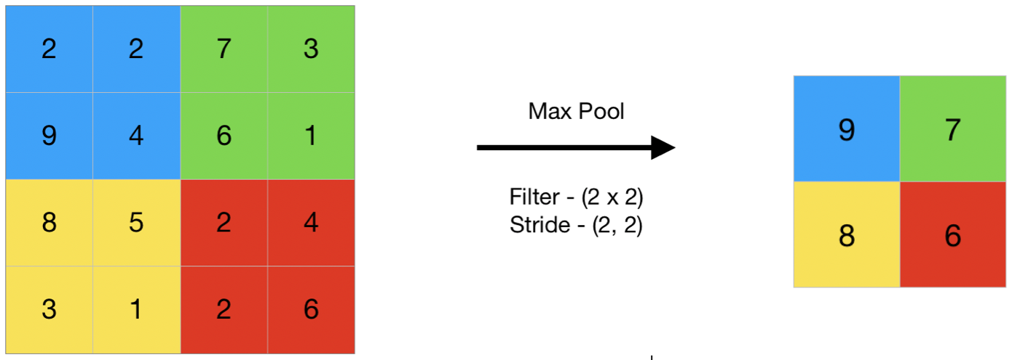
Types of Pooling Layer
Max Pooling: A pooling operation that selects the maximum element from the region of the feature map covered by the filter.
Similarly, Min Pooling.
Name of the Faculty: K. Hariprasath Program Name: B.Tech

Slide 10
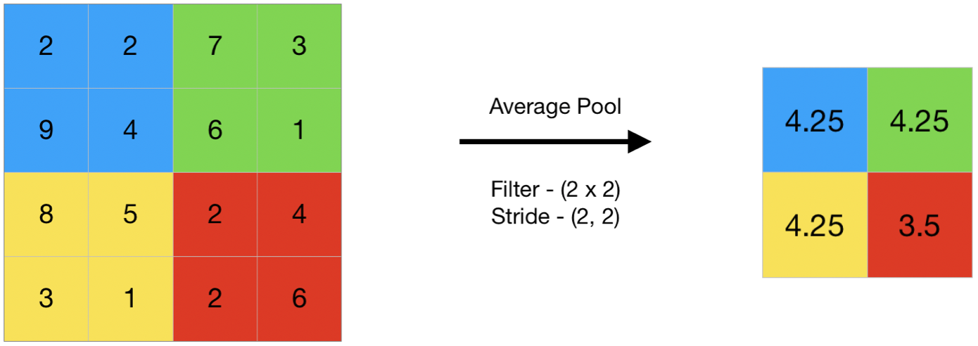
Types of Pooling Layer Cont’d …
Average Pooling: Computes the average of the elements present in the region of feature map covered by the filter.
So, average pooling gives the average of features present in a patch.
Name of the Faculty: K. Hariprasath Program Name: B.Tech

Slide 11
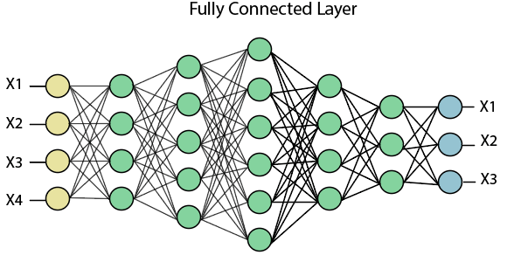
Fully Connected Layer of CNN
It is also called feed forward Neural Network.
It takes the output of previous layer and predict the best output.
Name of the Faculty: K. Hariprasath Program Name: B.Tech

Slide 12
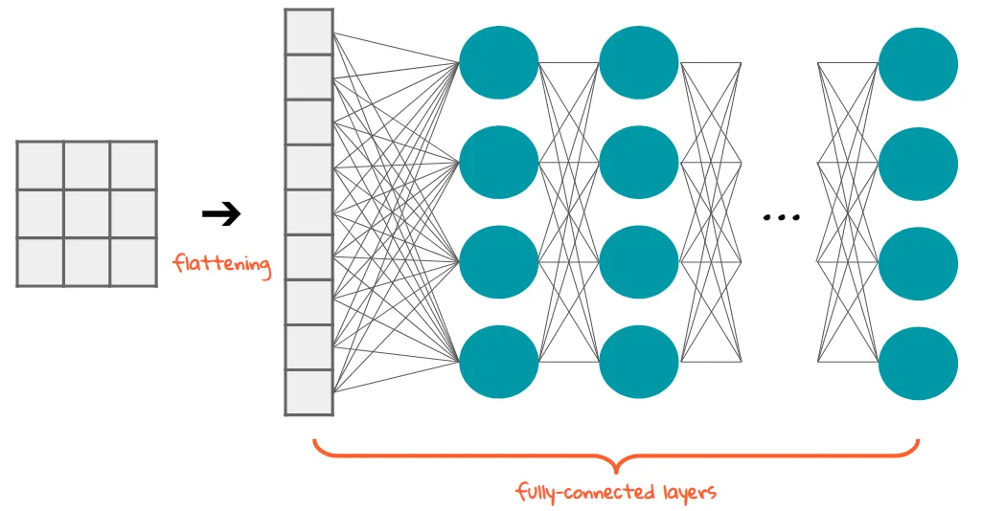
Flattening and Output Layers of CNN
Flattening is converting the data into a 1-dimensional array for inputting it to the next layer.
We flatten the output of the convolutional layers to create a single long feature vector.
And it is connected to the final classification model, which is called a fully-connected layer.
In other words, we put all the pixel data in one line and make connections with the final layer.
Name of the Faculty: K. Hariprasath Program Name: B.Tech

Slide 13
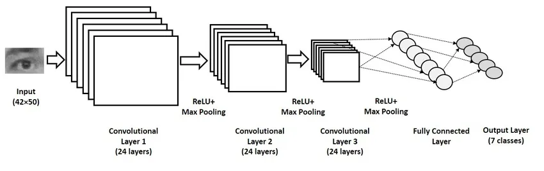
Flattening and Output Layers of CNN
Adding multiple convolutional layers and pooling layers, the image will be processed for feature extraction.
And there will be fully connected layers heading to the layer for softmax (for a multi-class case) or sigmoid (for a binary case) function.
Name of the Faculty: K. Hariprasath Program Name: B.Tech

Slide 14
Flattening and Output Layers of CNN
As the layers go deeper and deeper, the features that the model deals with become more complex.
For example, at the early stage of ConvNet, it looks up for oriented line patterns and then finds some simple figures.
At the deep stage, it can catch the specific forms of objects and finally able to detect the object of an input image.
Understanding CNN is understanding how the image data is processed. How to transfer images into data and extract the features for prediction.
From this basic structure, there are many modified and converged versions.
ResNet, AlexNet, VGG-16 or Inception Networks are some of them.
Name of the Faculty: K. Hariprasath Program Name: B.Tech

Slide 15
Applications of CNN
Decoding Facial Recognition
Analysing Documents
Collecting Historic and Environmental Elements
Understanding Climate
Understanding Gray Areas and many more
Name of the Faculty: K. Hariprasath Program Name: B.Tech

Slide 16


